Slide 1
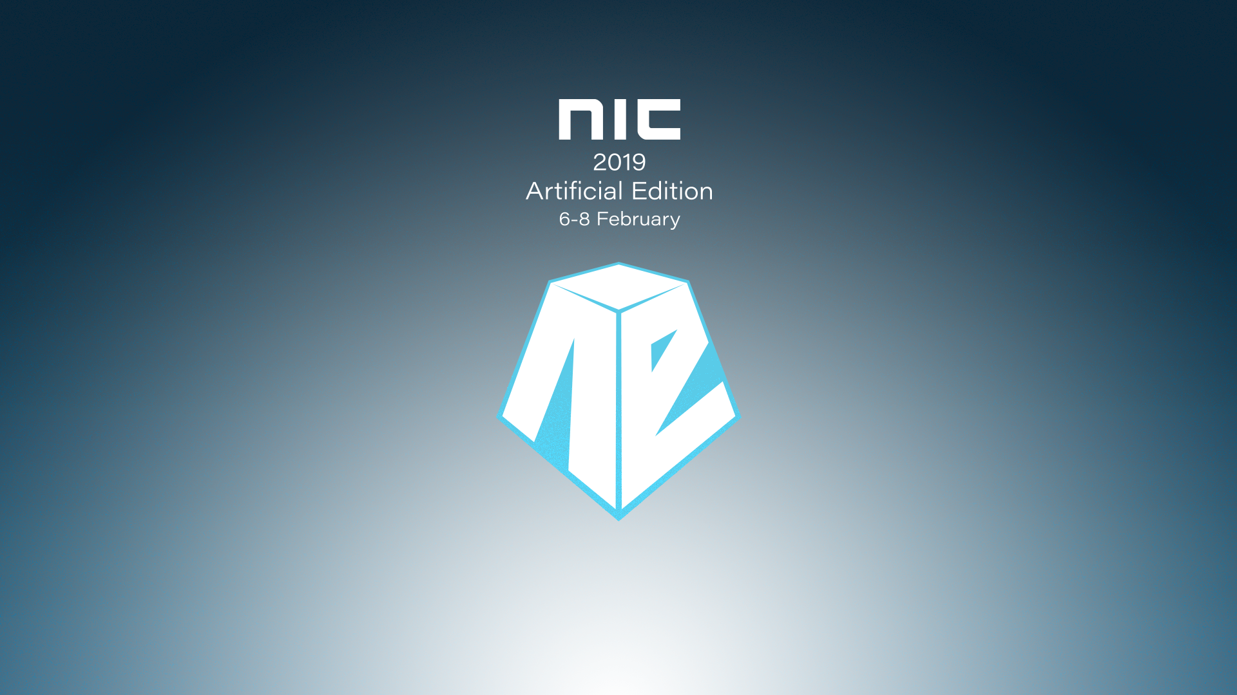

Slide 2
Creating and managing AWS infrastructure with PowerShell
Steve Roberts
Senior Technical Evangelist, Amazon Web Services
Twitter: @bellevuesteve

Slide 3
Who am I?
Previous seven years working as a Senior Developer at AWS
AWS SDK for .NET
AWS Toolkit for Visual Studio
AWS Tools for Microsoft Visual Studio Team Services (now Azure DevOps)
AWS Toolkit for Visual Studio Code
AWS Tools for PowerShell
Now a technical evangelist with a specialism for .NET and PowerShell on AWS

Slide 4
This Session
Explore opportunities to use PowerShell on AWS
Brief introduction to the AWS Tools for PowerShell
Using PowerShell script to build and deploy to AWS infrastructure
Using PowerShell with AWS CloudFormation
AWS Systems Manager and PowerShell
Notes:
There are so many places to make use of PowerShell on AWS!
Focus in on three
- pure script
- infrastructure as code!
- declarative & script mix
- service & script mix
In all cases we’ll also be using the AWS modules

Slide 5
AWS Tools for PowerShell

Slide 6
V1.0 shipped December 2012
Contained approx. 550 cmdlets across approx. 20 services
Latest version (v3.3.450.0, Feb 6th 2019)
5577 cmdlets across 160+ services!
Two modules
Windows PowerShell (v2+) – “AWSPowerShell”
PowerShell 6 (aka PowerShell Core) – “AWSPowerShell.NetCore”
High compatibility between the two modules
Almost all cmdlets map 1:1 to AWS service APIs
If you can code it in an SDK, you can script it in PowerShell!
Some ‘higher level’ cmdlets wrap multiple APIs (eg Write-S3Object)
Notes:
Extensive support for AWS services and service APIs for PowerShell users
We supported the PowerShell Gallery from day 1, and also PowerShell Core where we were a launch partner

Slide 7
Getting started with the AWS Tools for PowerShell
Notes:
First 5 mins:
How to install and configure credentials – gallery or msi
What services are supported?
What cmdlets are available for a service?
What cmdlet maps to a particular service API?
I have an AWS CLI command, what cmdlet does it map to?
Pre-installed on EC2 Windows and can get credentials/region automatically from instance metadata

Slide 8
What did we cover?
Installation options
Configuring credential profiles and region
How to determine supported services and cmdlets
How to map from service API ‘X’ to cmdlet
How to map from AWS CLI command to PowerShell cmdlet

Slide 9
Creating infrastructure from script
Notes:
Going to build a VPC to host an IIS-based web server fleet
VPC configured to best practices with public and private subnets
EC2 instances launch into the private subnets
Route tables and security groups prohibit direct access to the EC2 instances from the internet
Application load balancer in conjunction with public subnets permit external access
NAT gateway allows EC2 instances outbound access to the internet
Auto Scaling group defines how many instances, scaling configuration
This will all be built from a re-suable script - infrastructure as code is our goal
We will then construct the AWS CodeDeploy infrastructure to deploy our applications to the IIS fleet
- including performing a deployment from script

Slide 10
What are we going to build?
VPC (Virtual Private Cloud) in a region
Public subnets – one per AZ (Availability Zone)
Private subnets – one per AZ
Internet Gateway to allow inbound access from the internet
Route tables and security groups for the public and private subnets
Auto Scaling group and launch configuration
Places EC2 instances into private subnets
Application Load Balancer routing traffic to the EC2 instances via the public subnets
NAT gateway to allow outbound connectivity from the EC2 instances
EC2 instances will be configured as IIS web servers

Slide 11
Demo: infrastructure from pure script

Slide 12
What did we cover?
The range of cmdlets and supported services in the AWS modules means we can build almost anything from pure script!
We do need to be aware of eventual consistency
Not only can we build and configure infrastructure, we can also initiate deployments from PowerShell

Slide 13
Using PowerShell with AWS CloudFormation

Slide 14
AWS CloudFormation for beginners
Infrastructure provisioning service
Uses declarative templates (json or yaml) to define what you want
Service instantiates resources declared in template in a stack
Templates can be parameterized
We can specify commands in certain sections of the template
Define UserData scripts for EC2 instance resources
‘cfn-init’ statements for stack construction lifecycle
Both accept PowerShell content
We can also launch and manage stacks using PowerShell cmdlets
Notes:
Basic introduction to CloudFormation and declarative templates

Slide 15
Demo: launching stacks from PowerShell

Slide 16
What did we cover?
No eventual consistency worries – service handles waits etc
Editing PowerShell in JSON templates is somewhat awkward
YAML is a bit better but still…
Recommend downloading large scripts from inside templates to then run them
We can use generated proxy functions to wrapper AWS functionality and provide a more console-like experience over the raw API

Slide 17
AWS Systems Manager and PowerShell

Slide 18
What is AWS Systems Manager?
“Single pane of glass” to give you visibility and control of your infrastructure
View operational data from multiple services
Automate operational tasks across your resources
Simplified resource and application management
Easy to operate and manage your infrastructure securely at scale

Slide 19









AWS Systems Manager
Automation
Run command
Parameter Store
Maintenance windows
Documents
Session
Manager
Inventory
Patch manager
State manager
Notes:
Systems Manager is a collection of services
- Automation: automate common and repetitive IT operations and management tasks across AWS resources, with scheduling support
- Run Command: remote management of your instances at scale without logging into your servers
- Patch Manager: select and deploy operating system and software patches automatically across large groups of EC2 or on-premises instances
- State Manager: configuration management, which helps you maintain consistent configuration of your EC2 or on-premises instances
Four ancillary services
- Parameter store: centralized store to manage your configuration data, whether plain-text data such as database strings or secrets such as passwords
- Maintenance windows: schedule windows of time to run administrative and maintenance tasks across your instances
- Inventory: collects information about your instances and the software installed on them
- Session Manager: browser-based interactive shell and CLI for managing Windows and Linux EC2 instances, no SSH or RDP ports need to be opened
The ‘document’ is at the heart of Systems Manager
And it’s all available from PowerShell!

Slide 20
What is a document?
{
“schemaVersion”: “2.0”,
“description”: “Installs a Windows Feature”,
“parameters”: {
“feature”: {
“type”: “String”,
“description”: “Specify a package to install”
}
},
“mainSteps”: [ {
“action”: “aws:runPowerShellScript”,
“name”: “run”,
“inputs”: { “commands”: “Install-WindowsFeature {{feature}}” }
} ]
}
Notes:
A document contains metadata (schema, description), optional parameters plus the instructions to be run as a series of one or more steps

Slide 21
Demo: using PowerShell with Systems Manager

Slide 22
What did we cover?
Using Parameter Store from our scripts/command line
Using and creating Run Command documents
Using Session Manager to connect to instances
No open RDP or SSH ports!
Using serverless PowerShell functions to monitor deployed apps/infrastructure

Slide 23
Session summary

Slide 24
What did we cover?
Getting started with the AWS Tools for PowerShell
Using PowerShell script to build and configure AWS resources
Mixing PowerShell with AWS CloudFormation templates
Wrapping ‘raw API’ cmdlets with proxy functions
Using PowerShell-based documents with AWS Systems Manager
Using Session Manager to open PowerShell shells on EC2 instances
Serverless PowerShell with AWS Lambda to monitor infrastructure
Notes:
Useful links related to the session

Slide 25
Useful links
AWS modules on PowerShell Gallery
https://www.powershellgallery.com/packages/AWSPowerShell/
https://www.powershellgallery.com/packages/AWSPowerShell.NetCore/
AWS Tools for PowerShell Reference
https://docs.aws.amazon.com/powershell/latest/reference/
.NET/PowerShell homepage on AWS
https://aws.amazon.com/developer/language/net/
AWS Developer Blog articles on PowerShell
https://aws.amazon.com/blogs/developer/category/programing-language/powershell/

Slide 26

Slides and demos from the conference will be available at
https://github.com/nordicinfrastructureconference/2019

Slide 27
Thanks!
Twitter: @bellevuesteve
https://aws.amazon.com/developer/community/evangelists/steve-roberts/

